Slide 1
Culminating Experience Final Project Prediction of Local Epidemics of Dengue Fever
MPH Program
Biostatistics Concentration
Fall 2018
Umesh Singh

Slide 2
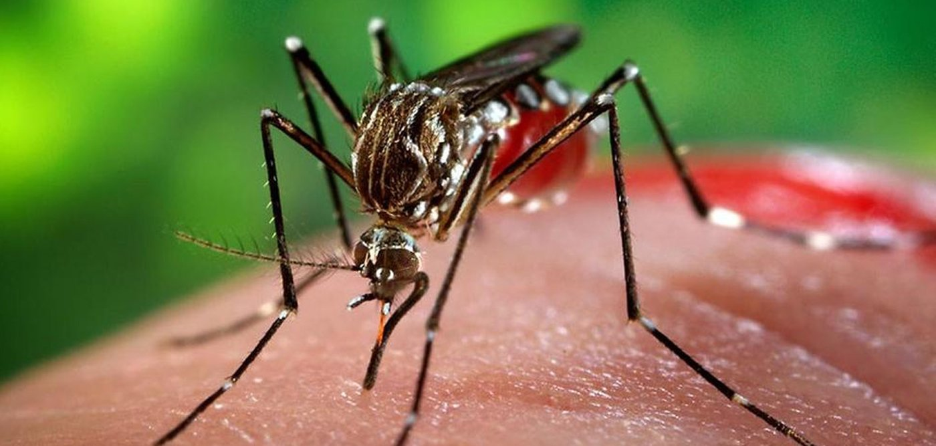
DengAI Predicting Disease Spread
HOSTED BY DRIVENDATA
https://www.drivendata.org/competitions/44/dengai-predicting-disease-spread/page/80/
Can you predict local epidemics of dengue fever?

Slide 3
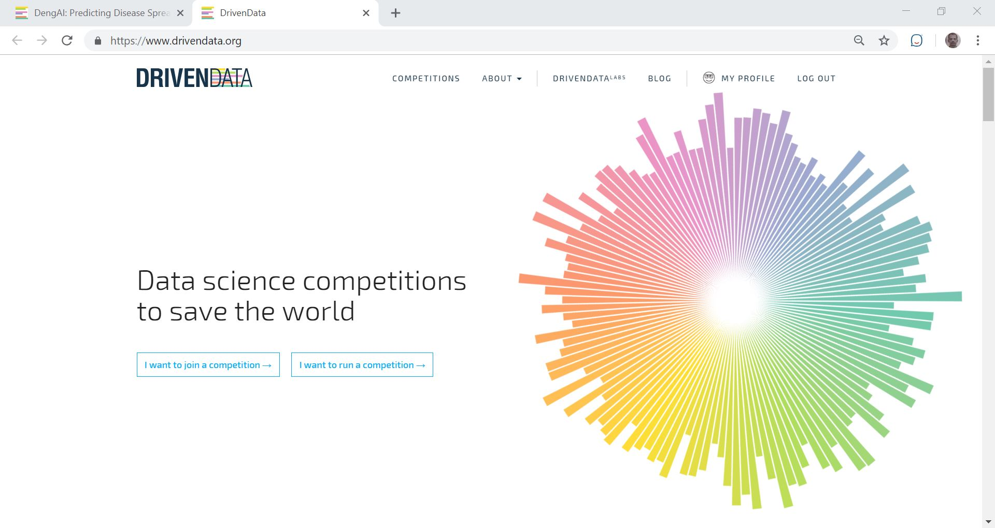

Culminating Experience Project
Labs
helps mission-driven organizations harness their data to work smarter, offer more impactful services, and use machine intelligence to its fullest potential.
launched a competition to use open data to predict the occurrence of Dengue based on climatological data.

Slide 4


Slide 5
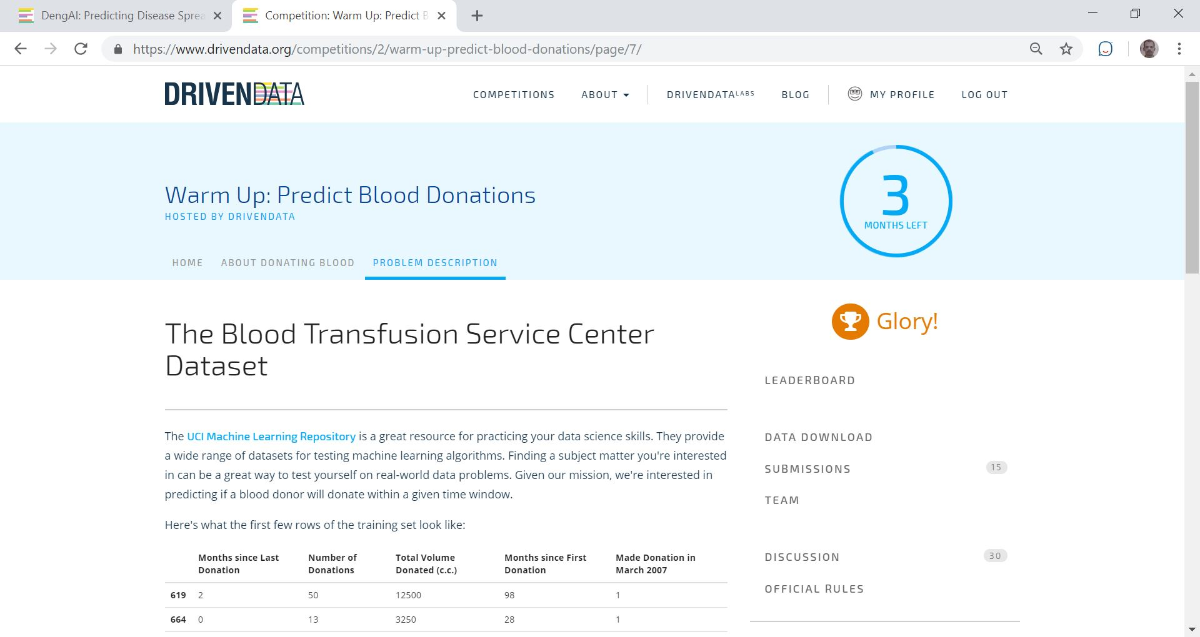
5

Slide 6
6

Slide 7
Dengue and Climate
most critical most rapidly spreading mosquito-borne viral disease in the world
spread by Aedes mosquitoes
in tropical and sub-tropical parts
mild cases: flu-like symptoms: fever, rash and body ache.
severe cases: severe bleeding aka hemorrhagic dengue, can be fatal.
Transmission dynamics of dengue
related to climate variables such as temperature and precipitation
7

Slide 8
Dengue and Public Health
a 30-fold increase in global incidence over the past 50 years.
>40 percent of the world’s population ~100 countries are at risk of dengue infection.
Each year worldwide
390 million dengue infections
500,000 cases develop into dengue hemorrhagic fever,
25,000 deaths
8

Slide 9
DengAI: Predicting Disease Spread
Accurate dengue predictions help public health workers and people around the world take steps to reduce the impact of these epidemics.
9

Slide 10
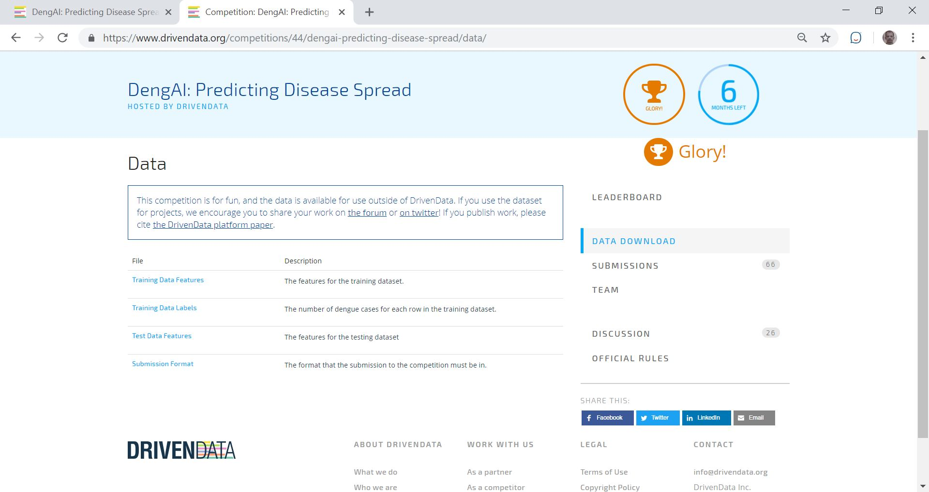
10

Slide 11
DengAI: Predicting Disease Spread
Sources of data
Dengue surveillance data
U.S. Centers for Disease Control and prevention
Department of Defense's Naval Medical Research Unit 6 and
Armed Forces Health Surveillance Center, in collaboration with the Peruvian government and U.S. universities.
Environmental and climate data
National Oceanic and Atmospheric Administration (NOAA), an agency of the U.S. Department of Commerce.
11

Slide 12
12

Slide 13
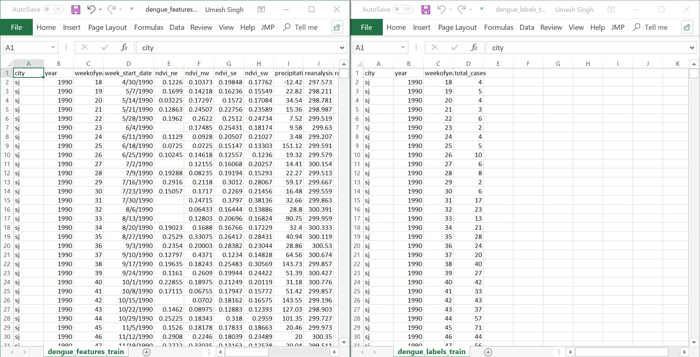
13

Slide 14
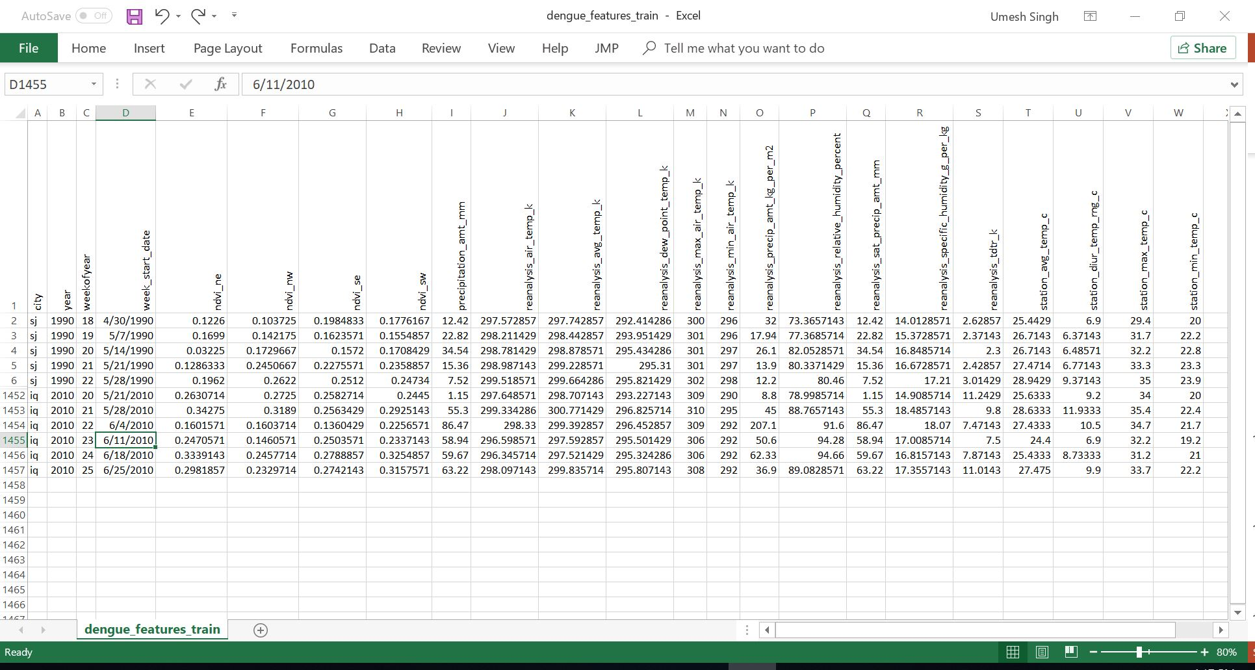
14

Slide 15
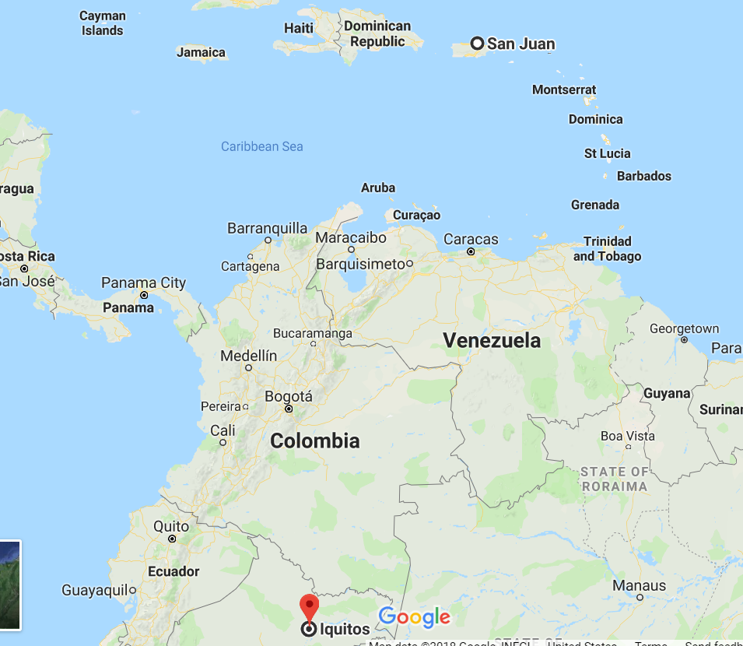
15

Slide 16
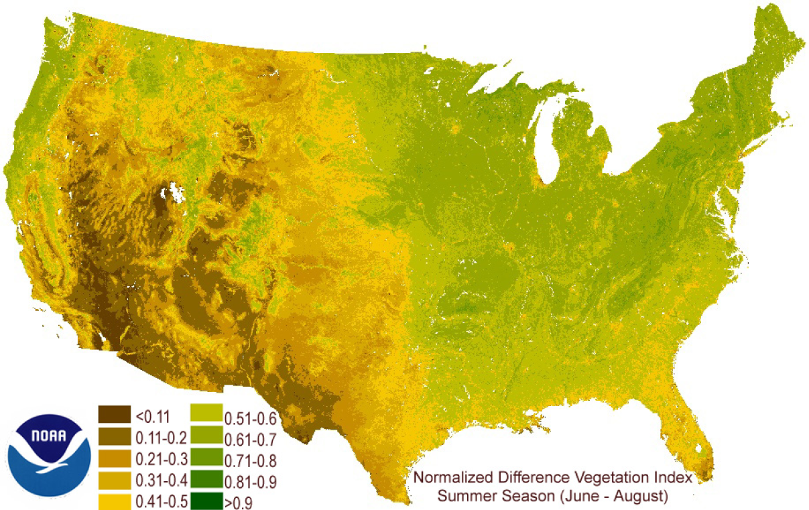
16

Slide 17
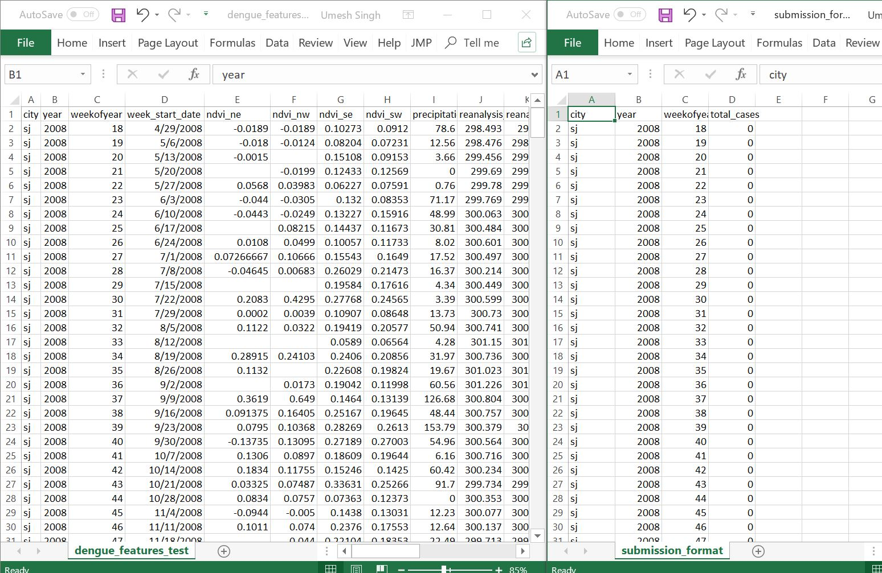
17

Slide 18
Problem Description and Plan
predict the total cases label for each (city, year, week of year) in the test set.
submit predictions for both cities.
Test set
San Juan and Iquitos have test data spanning 5 and 3 years respectively.
pure future hold-out
sequential and non-overlapping with any of the training data.
missing values
Goal
18

Slide 19
Machine Learning (ML) Algorithms Used To Predict the Number of Cases Per Week in the Test Set
Machine Learning
Supervised Learning
Unsupervised Learning
Classification
Regression
Clustering
Discriminant Analysis
Linear Reg, GLM
K-means
Naïve Bayes
SVR
Hierarchical
Nearest Neighbor
Ensemble
Gaussian mixture
Neural Networks
Decision Trees
Hidden Markov
Neural Networks
Neural Networks
19

Slide 20
Machine Learning (ML) Algorithms Used To Predict the Number of Cases Per Week in the Test Set
Machine Learning
Supervised Learning
Unsupervised Learning
Classification
Regression
Clustering
Discriminant Analysis
Linear Reg, GLM
K-means
Naïve Bayes
SVR
Hierarchical
Nearest Neighbor
Ensemble
Gaussian mixture
Neural Networks
Decision Trees
Hidden Markov
Neural Networks
Neural Networks
20

Slide 21
Description of the ML Algorithms
Type | Name | Description | Advantage | Disadvantage
Linear | Linear regression | “Best fit” line through all data points. Numerical predictions | Easily understood: Determine most significant drivers of the model | Too simple to determine complex relationships between variables Poor performance with correlated features
Tree-based | Decision tree | A series of yes/no rules based on the features, forming a tree, to match all possible outcomes of a decision | Easy to understand | Not used per se Too simple Not robust for complex data
 | Random Forest | Many decision trees: rules created from subsamples of features. Each tree weaker than that full decision tree Combining them > better overall performance | “Wisdom of the crowd” High quality models Fast to train | Models can be very large
 | Gradient boosting | Uses even weaker decision trees that are increasingly focused on ‘hard’ examples | High performing | Small change in the training set can create radical changes in the model. Difficult to understand predictions
Neural networks | Neural networks | Interconnected neurons that pass messages to each other. Uses several layers of neural networks stacked on top of one another | Can handle extremely complex tasks | Slow to train Difficult to understand predictions
21

Slide 22
Work Flow For The Project

Slide 23
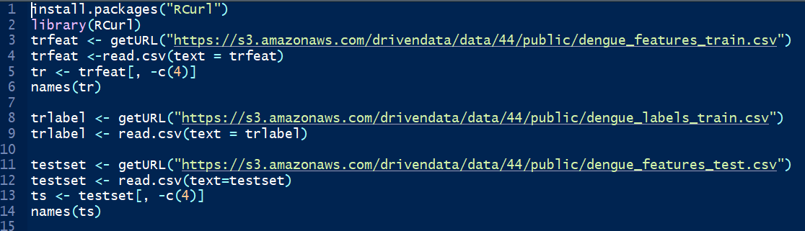
Loading Datasets
Method
23

Slide 24
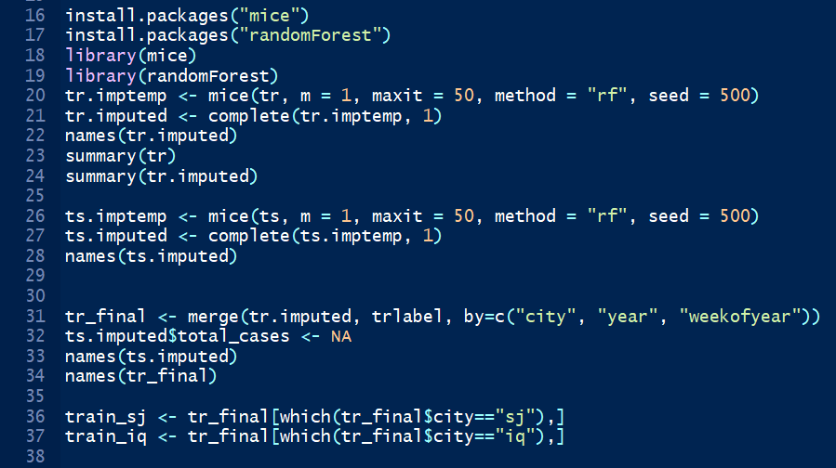
Loading Libraries
Method
This dataset has two cities
San Juan, PR
Iquitos, Peru.
Hypothesis
spread of dengue may follow different patterns between the two cities
divide the dataset train separate models for each city,
join predictions before making our final submission.
24
Notes:
Multivariate Imputation by Chained Equations

Slide 25
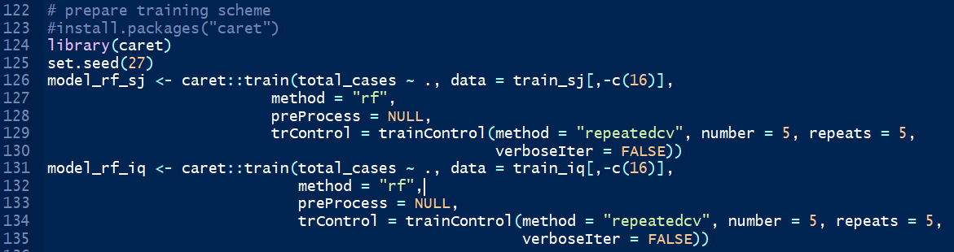
Prepare Training Scheme and Train the Prediction Model
Method
25

Slide 26
Predict Total Cases Per Week In the Test Data by City Using the Prediction Formula / Object / Regressor
Method
26

Slide 27
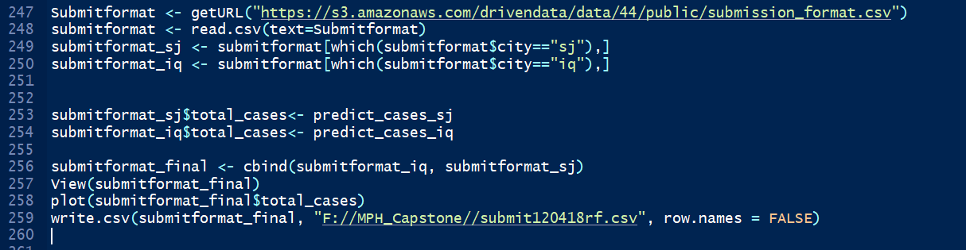
Method
Pull the Submit Format File and Subset by City and Populate The ‘total_cases’ Column With the Predicted Values from Prediction Formula
27

Slide 28
Ensemble Method Using Two or More Models with Synthesized Outputs
Premise
numerous models provide better accuracy than any single model.
ensemble models have better predictive power than single models when dengue incidence in a city are estimated using a dengue prediction model of that city together with its surrounding cities.
28

Slide 29
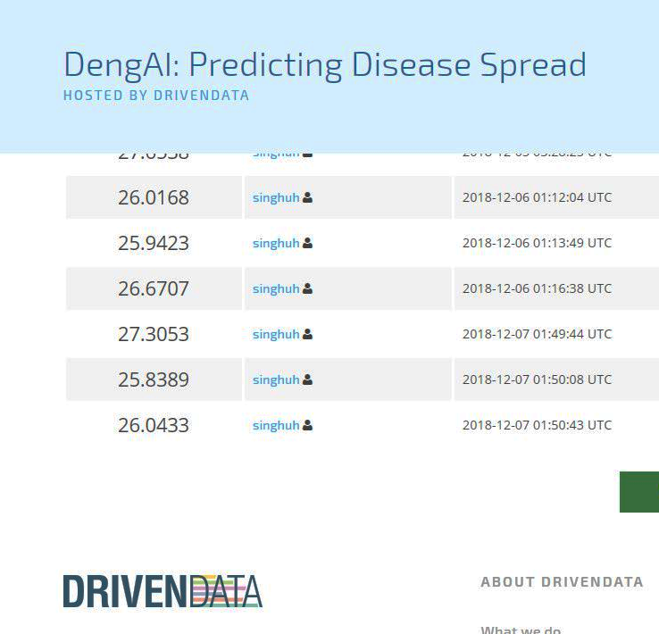
Ensemble Method Using Two or More Models with Synthesized Outputs
Boosted Tree
Averaged Prediction
Bootstrap Forest
29

Slide 30
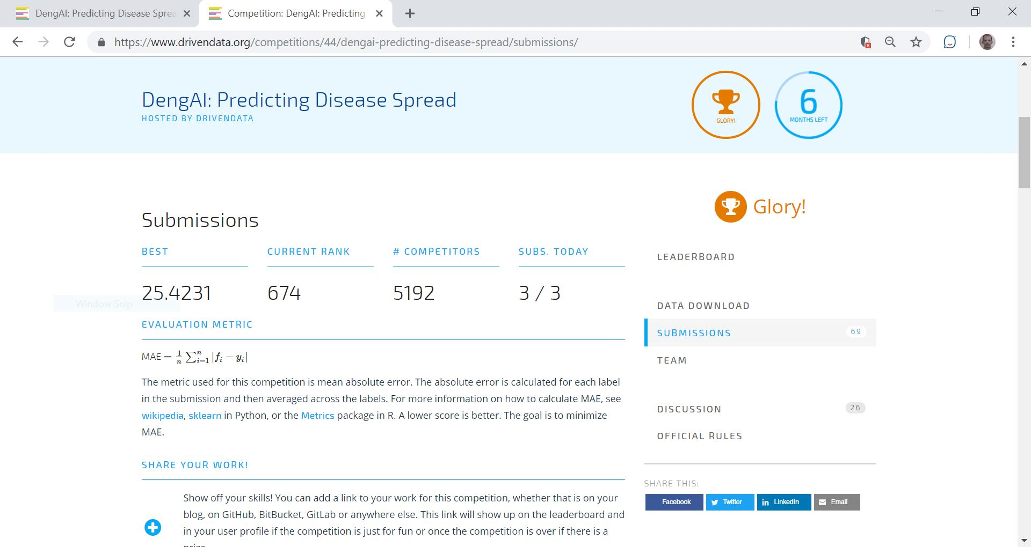
Current Ranks
30

Slide 31
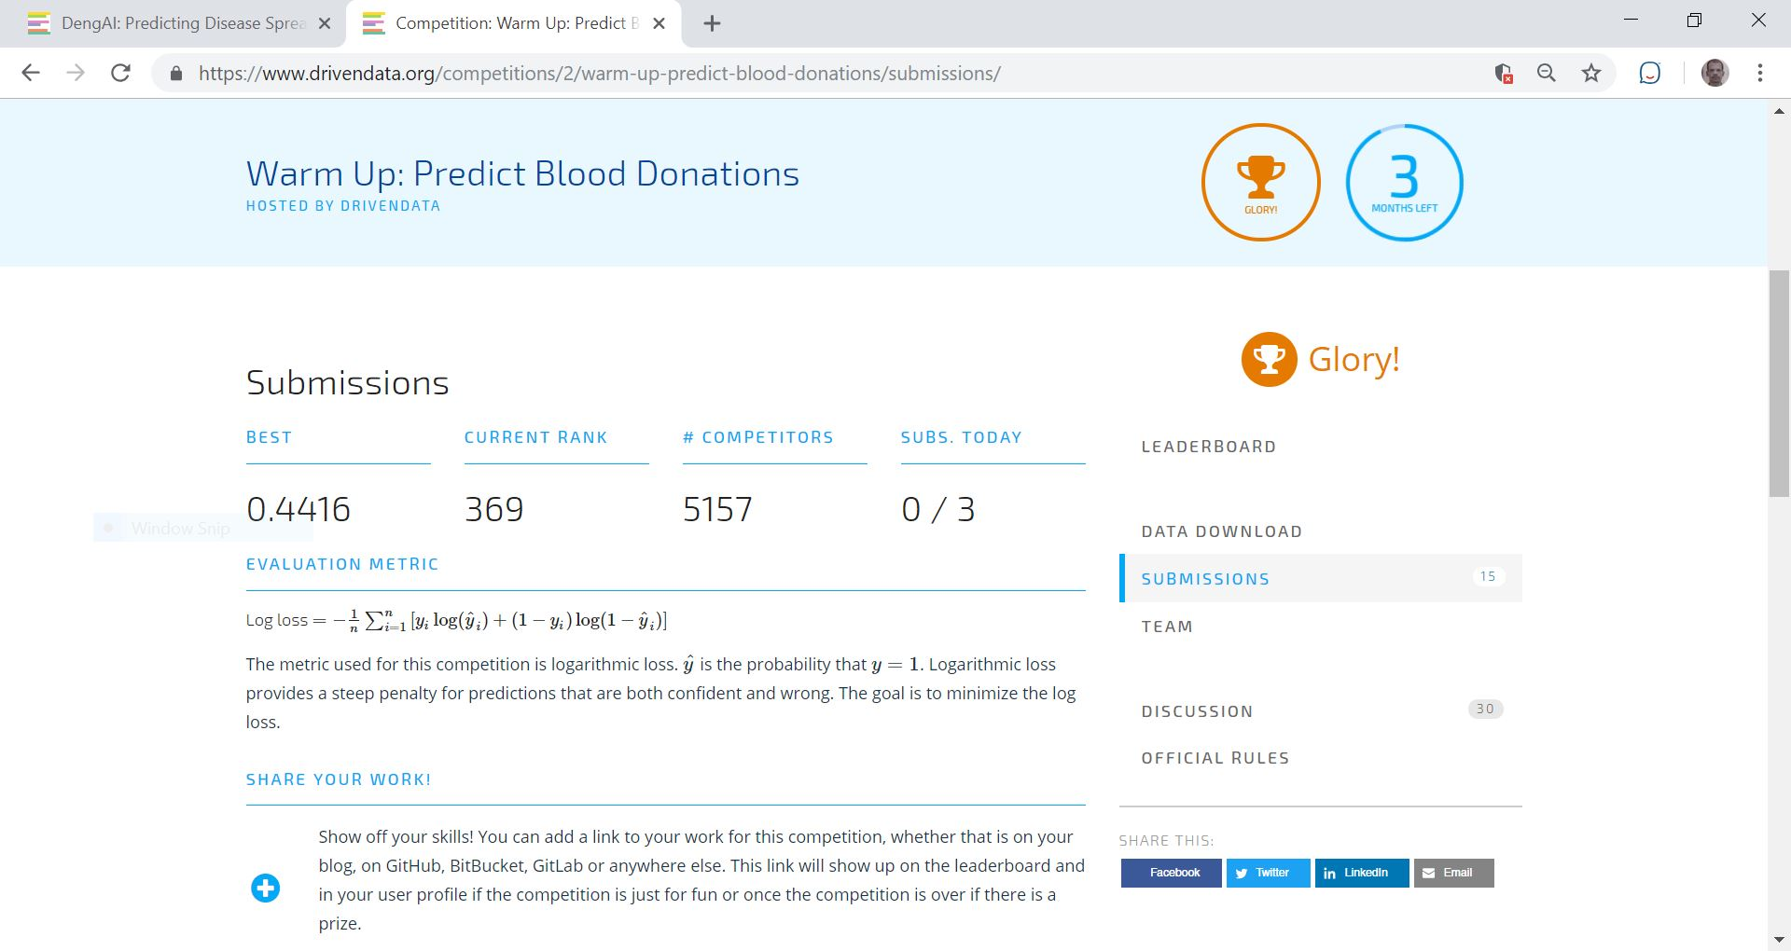
Current Ranks
31

Slide 32
Competencies
Core Competency: Evidence-based Approaches to Public Health
Apply epidemiological methods to the breadth of settings and situations in public health practice
Select quantitative and qualitative data collection methods appropriate for a given public health context
Analyze quantitative and qualitative data using biostatistics, informatics, computer-based programming and software, as appropriate
Interpret results of data analysis for public health research, policy or practice
Core Competency: Public Health & Health Care Systems
Compare the organization, structure and function of health care, public health and regulatory systems across national and international settings
Discuss the means by which structural bias, social inequities and racism undermine health and create challenges to achieving health equity at organizational, community and societal levels
Core Competency: Planning & Management to Promote Health
Assess population needs, assets and capacities that affect communities’ health
MPH Concentration Competencies: Biostatistics
Developed and refined skills in ML methods.
using several R-programming packages: caret, bartMachine, mice, Rcurl,
Using SAS/JMP
Gained better understanding of predictive modeling
32

Slide 33
Acknowledgement
Committee Chair
Dr. Ying
Committee Members
Dr. Vuong
Dr. Rao
Faculty, MPH Program

